Slide 1
COSO FRAMEWORK
The COSO Framework is a framework for designing, implementing and evaluating internal control for organizations, providing enterprise risk management.
Published for the Internal Control Integrated Framework (ICIF)
Framework was created in conjunction with five private sector organizations
COSO Framework is made up of two integrated frameworks with set of objectives.
Enterprise Risk Management(ERM)
Internal Control –Integrated framework-oldest framework 1992/Widely used
Committee of Sponsoring Organization of the Treadway Commission

Slide 2
COSO Framework Objectives
Internal control objectives
Operations - Focus on the effectiveness and efficiency of your business operations such as performance goals and securing the organization’s assets against fraud.
Reporting - Focus on transparency, timeliness and reliability of the organization’s reporting habits for both internal and external financial reporting as well as non-financial reporting.
Compliance - Focus on adherence to laws and regulations that the organization must comply with.
ERM – has the following objectives
Strategic – High-level goals, aligned with and supporting its mission
Operations – Effective and efficient use of its resources
Reporting – Reliability of reporting
Compliance – compliance with applicable laws and Regulations

Slide 3
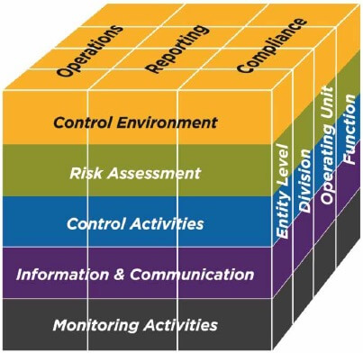
INTERNAL CONTROL-INTEGRATED FRAMEWORK
The new internal control framework(2013) has 5 components(Class of controls) 17 principles (Family of controls) and 87 attributes(Control requirements)
Five components to an Internal control system.
Control environment
Risk Assessment
Control Activities
Information and Communication
Monitoring

Slide 4
Principles of effective internal control
Control Environment
Demonstrates commitment to integrity and ethical values
Exercises oversight responsibility
Establishes structure, authority and responsibility
Demonstrates commitment to competence
Enforces accountability
5 principles, and 20 attributes
Risk Assessment
Specifies suitable objectives
Identifies and analyzes risk
Assesses fraud risk
Identifies and analyzes significant change
4 principles, and 27 attributes
Control Activities
Selects and develops control activities
11. Selects and develops general controls over technology
Deploys through policies and procedures
3 principles, and 16 attributes
Information & Communication
Uses relevant information
Communicates internally
Communicates externally
3 principles, and 14 attributes
Monitoring Activities
Conducts ongoing and/or separate evaluations
Evaluates and communicates deficiencies
2 principles, and 10 attributes
https://www.coso.org/Pages/ic.aspx

Slide 5
Control Examples
Establish Responsibilities
Tasks should be clearly established, assigned to individuals in order to determine faults.
Process owner and reviewer must be different
SODs controls
Maintain Adequate Records
Detailed Records
Use of Chart of Accounts

Slide 6
SAMPLE MAPPING
Component
Principle
Controls embedded in other components may effect this principle
Control Environment
1. The organization demonstrates a commitment to integrity and ethical values.
Human Resources review employees’ confirmations to assess whether standards of conduct are understood and adhered to by staff across the entity
Control Environment
Management obtains and reviews data and information underlying potential deviations captured in whistleblower hot-line to assess quality of information
Information & Communication
Internal Audit separately evaluates Control Environment, considering employee behaviors and whistleblower hotline results and reports thereon
Monitoring Activities

Slide 7
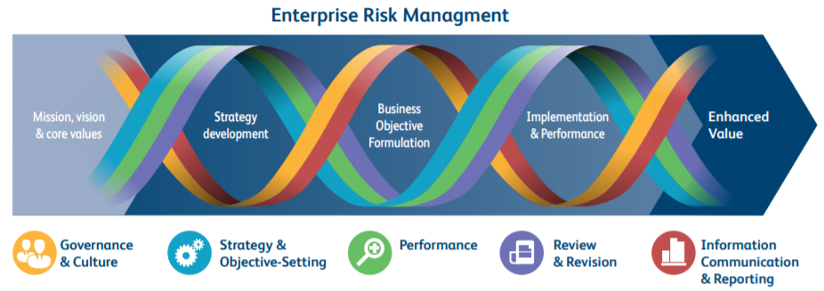
Components of ERM
COSO’s new ERM framework now includes five components or categories with 20 principles spread throughout each component. Those components are:
Governance and Culture
Strategy & Objective-Setting
Performance
Review and Revision
Information, Communication, and Reporting

Slide 8
COBIT FRAMEWORK
The COBIT Framework is a framework for created by the ISACA (Information Systems Audit and Control Association) for IT governance and management.
Designed to be a supportive tool for managers—and allows bridging the crucial gap between technical issues, business risks, and control requirements.
COBIT ensures quality, control, and reliability of information systems in an organization
COBIT framework is focused on SOX IT Process/General IT process.
CONTROL OBJECTIVE FOR INFORMATION AND
RELATED TECHNOLOGY

Slide 9
Objectives - COBIT 2019 lays out ‘Governance Objectives’ and ‘Management Objectives’, with a total of 40 as part of its ‘Core Model’. Practitioners prioritize these objectives based on the needs of customers, stakeholders, users, and so on, allowing them to create comprehensive and bespoke IT strategies and frameworks
Domains - Every COBIT objective fits within a specific ‘Domain’. Management Objectives are contained within ‘Deliver, Service and Support (DSS)’, ‘Monitor, Evaluate and Assess (MEA)’, ‘Build Acquire and Implement (BAI)’, and ‘Align, Plan and Organize (APO)’. Governance Objectives are found under ‘Evaluate, Direct and Monitor (EDM)’
Goals Cascade - This tool is used to demonstrate how drivers create needs, and subsequently create more clearly defined ‘goals’. In COBIT 2019, these are known as ‘Alignment Goals’, as opposed to the ‘IT Goals’ from COBIT 5
Components - Formerly known as ‘Enablers’, Components are generic elements that influence IT. They include ‘Information Flows’, ‘Skills’, ‘Infrastructure’, ‘Processes’, ‘Policies and Procedures’, and ‘Organizational Structures’. COBIT 2019 also introduced ‘variants of generic’, with which Components can be examined and amended based on a ‘Focus Area’, such as a specific piece of legislation like the GDPR
Design Factors - These factors help define the needs of an organization and how they must be addressed in a framework. Contextual factors, such as corporate and threat landscapes, are beyond the organization’s control. Strategic factors reflect decisions by the organization, such as the direction of enterprise strategy and the prioritization of different IT elements. Tactical factors focus on implementation choices regarding technology (such as cloud data), methods (such as DevOps, ITIL 4, or Agile), and outsourcing models

Slide 10
CONTROL OBJECTIVE FOR INFORMATION AND RELATED TECHNOLOGY (COBIT)
The COBIT framework makes a clear distinction between governance and management. These two disciplines encompass different activities, require different organizational structures and serve different purposes.
Governance of Enterprise IT - Evaluate, Direct and Monitor (EDM) – 5 processes
Stakeholder needs, conditions and options are evaluated to determine balanced, agreed-on enterprise objectives.
Direction is set through prioritization and decision making.
Performance and compliance are monitored against agreed-on direction and objectives.
Management of Enterprise IT
Align, Plan and Organize (APO) – 13 processes
Build, Acquire and Implement (BAI) – 10 processes
Deliver, Service and Support (DSS) – 6 processes
Monitor, Evaluate and Assess (MEA) - 3 processes

